Slide 1
Module B
Unit B4
Vocabulary
Language Functions
Speaking Activities
UTN FRVM Lic. Evangelina Cecchel - Lic. Bibiana Fernandez

Slide 2
Language Functions:
Asking permission
and offering help
UTN FRVM Lic. Evangelina Cecchel - Lic. Bibiana Fernandez

Slide 3
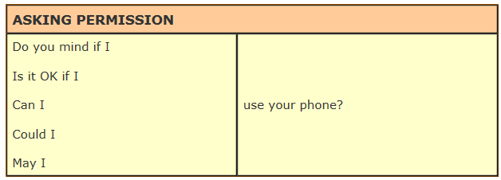
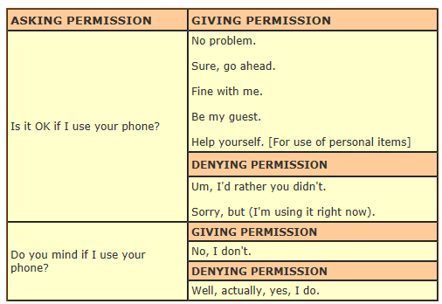
UTN FRVM Lic. Evangelina Cecchel - Lic. Bibiana Fernandez

Slide 4



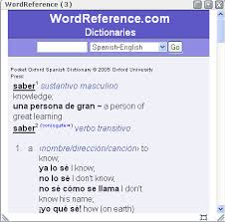

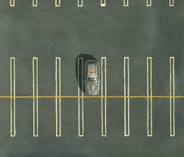
Asking Permission
UTN FRVM Lic. Evangelina Cecchel - Lic. Bibiana Fernandez

Slide 5
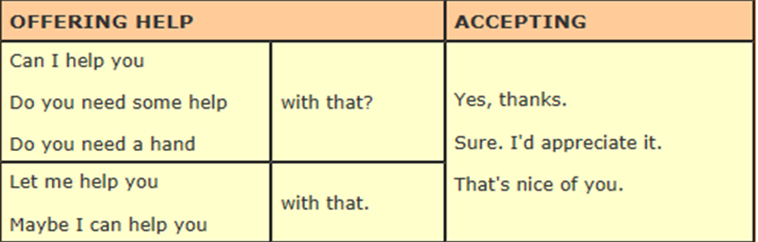
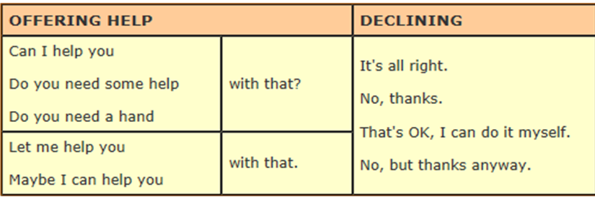
UTN FRVM Lic. Evangelina Cecchel - Lic. Bibiana Fernandez

Slide 6


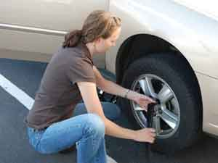
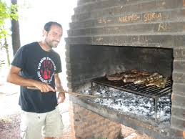
Offering help
UTN FRVM Lic. Evangelina Cecchel - Lic. Bibiana Fernandez

Slide 7
Language Functions:
Expressing Necessity
UTN FRVM Lic. Evangelina Cecchel - Lic. Bibiana Fernandez

Slide 8
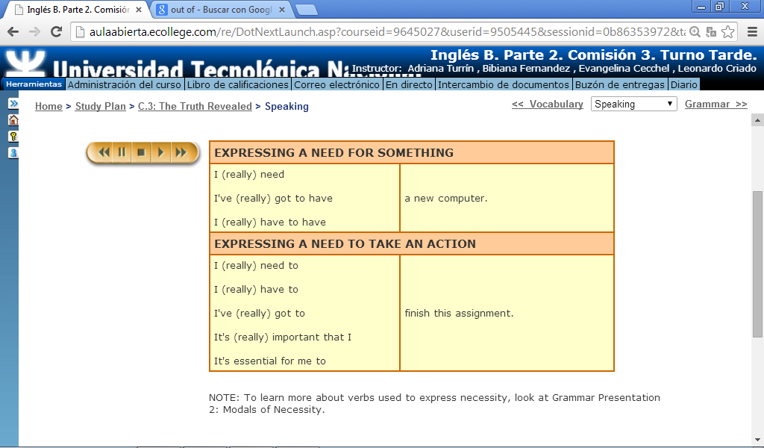
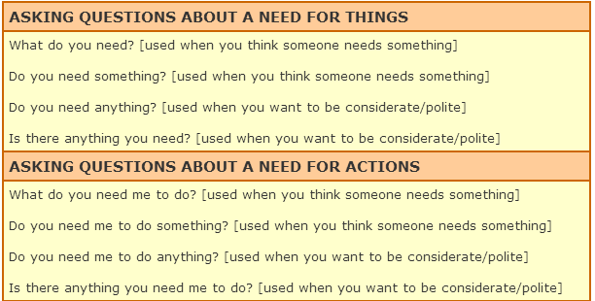
UTN FRVM Lic. Evangelina Cecchel - Lic. Bibiana Fernandez

Slide 9
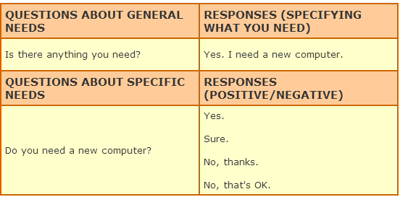
Make a list of things you need (to have or do).
Ask and answer questions expressing needs.
E.g.: Go to the dentist,
Buy food/clothes/tickets, etc.
UTN FRVM Lic. Evangelina Cecchel - Lic. Bibiana Fernandez

